Slide 1

TOPIC 4
Workflow Engineering with LLM Frameworks
PREPARED BY INSTRUCTOR TEAM

Slide 2
CONTENTS
01 Introduction to AI Workflow
02 Chaining & Execution Patterns
03 Managing State, Memory, and Persistence
04 Document Ingestion Pipelines
05 Modular Workflow Design
06 Orchestration Framework

Slide 3
01
Introduction
to AI Workflow
An overview of AI Workflow, covering their purpose, key characteristics, automation levels, core components, and popular frameworks. It also explains how workflows make LLM applications more structured, reliable, and scalable.

Slide 4
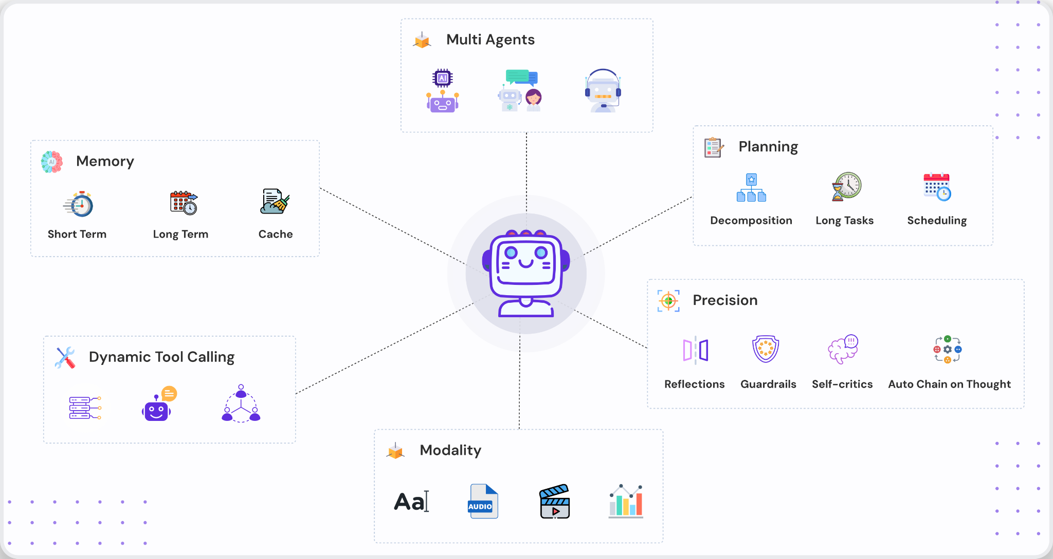
What is AI Workflow?
INTRODUCTION TO AI WORKFLOW
AI Workflow is the process of combining multiple LLM calls, tool usages, and data-processing steps into an organized, automated pipeline.

Slide 5
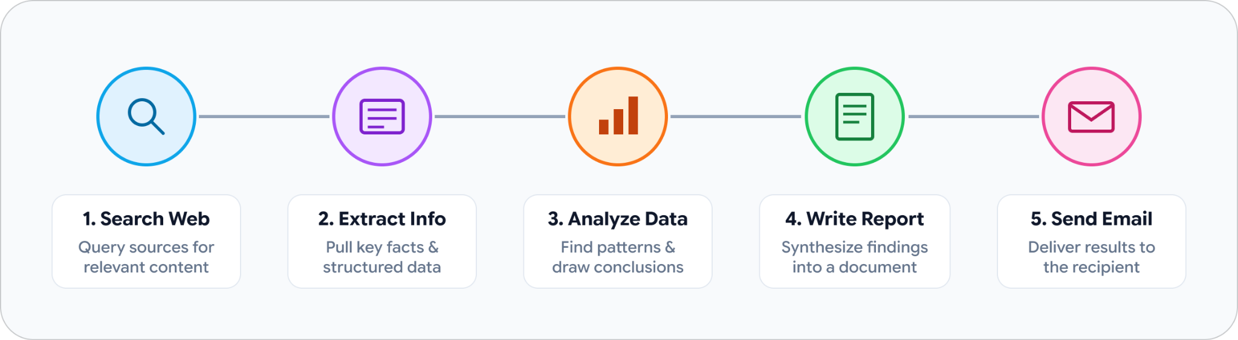
What is AI Workflow?
INTRODUCTION TO AI WORKFLOW
A single LLM call can answer a simple question. But real-world tasks often require multiple steps:
Example: “A manager wants a weekly competitor analysis sent to their team every Monday morning.”
An AI Workflow connects these steps together, allowing AI to automatically complete an entire task rather than simply generating a single response.

Slide 6
Key Characteristics
INTRODUCTION TO AI WORKFLOW
Unlike a one-shot API call, an AI Workflow can:
Decompose a complex problem into multiple steps
Each step can use a different model
Validate intermediate results before continuing
Branch based on conditions or results
Run tasks in parallel through multiple execution paths
Combine outputs to produce the final result

Slide 7
Why We Need It (Problem Statement)
INTRODUCTION TO AI WORKFLOW
The Problem
  A single LLM call is like an intern with a great memory but no structure.
  If you ask it to "write a whole software project, test it, and deploy it" in one prompt, it will fail.
  It hits context limits, hallucinates details, and has no memory of what it did two steps ago.
The Goal:
  We need a way to take a big, messy task and break it down into clean, manageable, reliable steps.
The Solution (Workflow Engineering / AI Workflow):
  This is the practice of designing, building, and managing structured pathways where code and AI work together step-by-step to get complex jobs done reliably.

Slide 8
The 4 Levels of AI Capability / Levels of AI Automation
INTRODUCTION TO AI WORKFLOW
Each level gives AI more autonomy, handles more complexity, and requires less human intervention.
Level 1
Single Q&A (Prompting)
Flow:
User Input LLM Output.
Example: "Write me a poem."
Limit: Only works for one-off, simple tasks.
Level 2
Chaining (Workflows)
Flow:
Step A Step B Step C
Example:
Translate text, summarize, and polish grammar.
Limit: The path is fixed; It cannot change direction midway based on what it discovers.
Level 3
Agentic Workflows (Agents)
Flow:
Dynamic loops where an AI looks at the data, decides which tool to use next, fixes its own mistakes, and stops when finished.
Example:
Research a topic, search the web, write a report, check for errors, and rewrite if needed.
Level 4
AI System
Flow:
Combines LLMs, agents, workflows, tools, memory, data sources, and external APIs into a larger operational platform.
Example:
An AI customer-support system that receives requests, retrieves customer information, decides how to respond, calls external APIs, escalates difficult cases to humans, and continuously monitors unresolved issues.
1
2
3
4

Slide 9
AI Workflow: Core Components
INTRODUCTION TO AI WORKFLOW
A complete AI Workflow relies on six foundational pillars:
The LLM — the brain of the workflow; reasoning & generation
Tools — external actions
Memory — information retention
State — execution context
Router — control flow
Human-in-the-loop (HITL) — human approval

Slide 10
AI Workflow: Core Components (conts)
INTRODUCTION TO AI WORKFLOW
Component | Description
LLM | The brain of the workflow, responsible for reasoning, text generation, planning, and decision-making. Examples: GPT-4o, Claude 3.5, Gemini 1.5, Llama 3.
Tools | Allow the LLM to interact with external systems such as web search, databases, calculators, APIs, or code execution.
Memory | Enables the workflow to retain and retrieve information when needed. • Short-term Memory: Stores the current conversation history, typically included in the prompt. • Long-term Memory: Persists information across sessions, often using databases and retrieval mechanisms such as RAG.
State | The information and context carried between workflow steps, like a relay baton. Each step can read previous results and write new results for subsequent steps.
Router / Condition | Determines what happens next based on the current state or previous output. It enables branching, looping, conditional execution, and workflow transitions.
Human in the Loop (HITL) | Pauses the workflow at critical points and waits for human confirmation or approval. Useful for high-risk actions such as deleting data, sending emails, approving transactions, or financial operations.

Slide 11







What is an LLM Framework?
INTRODUCTION TO AI WORKFLOW
An LLM framework is a library or SDK that helps developers build applications on top of large language models. Instead of writing raw API calls to OpenAI, Anthropic, or Mistral and managing all the surrounding logic yourself, an LLM framework provides structured abstractions for common tasks.

Slide 12
LLM Frameworks & AI Tools - Quick List (cont)
INTRODUCTION TO AI WORKFLOW
To build these workflows in production, developers use orchestration frameworks. Here is a brief comparison of the industry standards:
Framework | Positioning | Best Used For | Real Task Example
LlamaIndex | Specialized RAG Framework (Strongest data processing) | Searching and querying massive documents & PDFs. | Finding specific clauses inside a 500-page legal contract.
CrewAI | Multi-Agent Collaboration (Role-playing framework) | Teams of AI specialists working together. | A researcher AI gathering data, an analyst finding gaps, and a writer drafting a report.
LangGraph | Graph Agent Framework (stateful workflows) | Complex workflows with loops and human approval. | A refund system that calculates amounts and pauses for a manager's click to approve.
LangChain | Code-First Framework (most complete ecosystem) | General-purpose apps with massive tool integration. | A custom chatbot querying an internal SQL database for live sales data.

Slide 13
LLM Frameworks & AI Tools - Quick List (cont)
INTRODUCTION TO AI WORKFLOW
Here is a brief comparison of the industry standards:
Framework | Positioning | Best Used For | Real Task Example
AutoGen | Multi-Agent Conversation Framework (Message-passing system) | Chat-based, interactive multi-agent dialogue. | A coder AI writing a script and a reviewer AI testing it, passing fixes back and forth.
n8n (Platform) | Universal Workflow Automation (Includes AI nodes) | Connecting traditional apps (Slack, Gmail) with AI. | Capturing a lead form, using AI to score it, and alerting Slack.
Dify (Platform) | Visual Low-Code (Full-stack AI platform) | Zero-code visual app building and rapid deployment. | Building a customer helpdesk chatbot connected to a wiki in 10 minutes.
Note:
With Coding Experience : LangChain, LangGraph, LlamaIndex, CrewAI, AutoGen
Non-Technical Background : Dify / n8n

Slide 14
AI Workflows In Short
INTRODUCTION TO AI WORKFLOW
AI Workflows: Combining multiple LLM calls, tools, and data-processing into an automated pipeline rather than single prompt.
Problem: Single prompts hit context limits, hallucinate, and lack memory/structure for complex tasks.
Solution: Workflow engineering breaks big tasks down into structured, reliable steps.
The 4 Levels of AI Capability
  Level 1 (Q&A) : Simple one-off prompt response.
  Level 2 (Chaining) : Fixed sequential pipeline (Step A → B → C).
  Level 3 (Agents) : Dynamic loops with error correction and tool use.
  Level 4 (AI System) : Integrated platforms with multi-agent orchestration.

Slide 15
AI Workflows In Short (conts)
INTRODUCTION TO AI WORKFLOW
Core Components
  LLM : Brain for reasoning, text generation, and planning.
  Tools : External integrations (search, databases, APIs).
  Memory & State : Retention across sessions and passing context as a relay baton.
  Router & HITL : Controls branching/loops and enforces human approval gates.
Top Frameworks Quick List
  LlamaIndex : Specialized data processing & RAG pipelines.
  CrewAI : Multi-agent role-playing collaboration teams.
  LangGraph : Stateful graph agents with complex loops and controls.
  LangChain : Code-first general-purpose ecosystem.

Slide 16
02
Chaining
& Execution Patterns
An overview of LLM Chaining, including how it differs from workflows, why chaining is needed, its benefits, and key patterns such as Sequential Chaining and Conditional Routing.

Slide 17
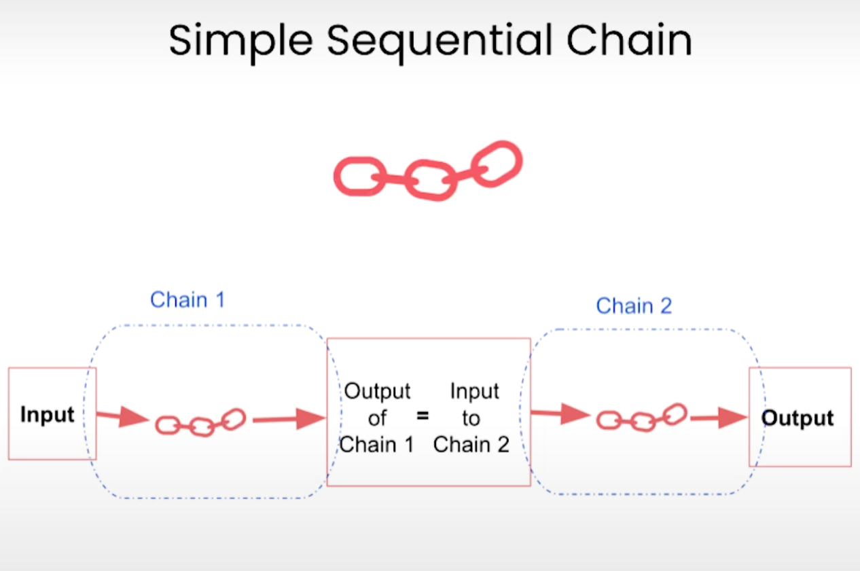
What is LLM Chaining?
CHAINING & EXECUTION PATTERNS
LLM Chains / Chaining is a technique in AI for connecting multiple LLMs or their outputs to other applications, tools, and services to get the best responses or to do complex tasks.

Slide 18
LLM Workflow vs. LLM Chains
CHAINING & EXECUTION PATTERNS
Term | What it means | Is it a full system?
LLM Workflow / Multi-Step LLM Workflow / Chaining Multi-Step Workflow | A complete, engineered pipeline built using chains, state, routing, tools, and error handling. | Yes, this is the complete production architecture.
Chaining / LLM Chains | The basic concept of linking steps together (A -> B -> C). | No, it's just the connection pattern.
In short
All multi-step workflows are built using chaining.
But a simple 3-step chain is just a "chain," not yet a full production "workflow" until you add state, routing, and error handling.

Slide 19
LLM Workflow vs. LLM Chains
CHAINING & EXECUTION PATTERNS
Can an LLM workflow exist without chaining?
Yes. While most complex pipelines use chaining, an LLM workflow can also function without it under specific architectures:
Single-Inference Augmented Workflows: Code retrieves external data (like a RAG search) and passes it into a single LLM call without multi-step handoffs.
Parallel Execution (Fan-Out): Multiple independent LLM calls run simultaneously on separate tasks, and code aggregates the results instead of passing output A into input B.

Slide 20
The Problem Statement - Chaining
CHAINING & EXECUTION PATTERNS
Imagine you give an LLM a massive, multi-part task in a single prompt:
"Read this 50-page financial report, extract the key risks, translate them into Spanish, check if they violate company policy, and format them into an executive email."
If you try to do this all in one single model call, you will run into massive problems:
The "Too Many Hats" Problem (Attention Drift): One LLM handles accounting, translation, compliance, and copywriting, causing attention drift and lower quality.
Compound Hallucinations: Errors in one step cascade through every subsequent step.
Zero Control and Auditability: If the final email is wrong, you have no idea where it failed. Was it the extraction? The translation? The policy check?

Slide 21
The Solution: Why Chaining?
CHAINING & EXECUTION PATTERNS
Chaining solves this by breaking the giant task down into a line of small, focused specialists (an assembly line). Instead of one giant prompt, you create a chain of steps:
"Read this 50-page financial report, extract the key risks, translate them into Spanish, check if they violate company policy, and format them into an executive email."
Step 1 : Extract financial risks (LLM specialized only in reading data).
Step 2 : Translate extracted risks to Spanish (LLM/Tool specialized only in translation).
Step 3 : Run a deterministic code check against company policy rules (Python code, not even an LLM).
Step 4 : Format the final output into an email template.

Slide 22
Why LLM chains are useful
CHAINING & EXECUTION PATTERNS
Chaining lets applications do things like work with multiple files, refine content iteratively, and improve responses.
It also overcomes some inherent limitations of LLMs themselves:
  Overcomes context window limits by breaking down large documents into manageable parts.
  Extends conversation memory beyond standard chat sessions via external state/memory storage.
  Translates standard text outputs into structured formats like CSV files, flow charts, or knowledge graphs.

Slide 23
Why LLM chains are useful (cont)
CHAINING & EXECUTION PATTERNS
They let you build applications like LLM agents and retrieval augmented generation (RAG) systems that typically include:
  Input processing and prompt formatting for the LLM.
  APIs for connecting LLMs with external services.
  Processing, parsing, and validating LLM outputs.
  Retrieving external data, such as vector embeddings, to enhance RAG applications.
But putting together an LLM chain isn’t always straightforward, which is why orchestration frameworks like LangChain and LlamaIndex exist, though these have their own inefficiencies that we’ll discuss later on.

Slide 24
Core Chaining Patterns
CHAINING & EXECUTION PATTERNS
Chaining Patterns are foundational structural blueprints for connecting multiple LLM calls, deterministic code, and external tools into a multi-step workflow.
As workflows become more complex, different chaining patterns define how data and control flow between steps.

Slide 25
Core Chaining Patterns (cont)
CHAINING & EXECUTION PATTERNS
Common chaining patterns include:
  Sequential Chain — execute steps one after another.
  Conditional Routing — choose the next step based on a condition.
  Parallel Execution — execute multiple independent steps simultaneously.
  Evaluator–Optimizer — generate, evaluate, and iteratively improve an output.
  Orchestrator–Worker — a central orchestrator delegates tasks to specialized workers.
In this course, we focus on two fundamental patterns: Sequential Chain and Conditional Routing.

Slide 26
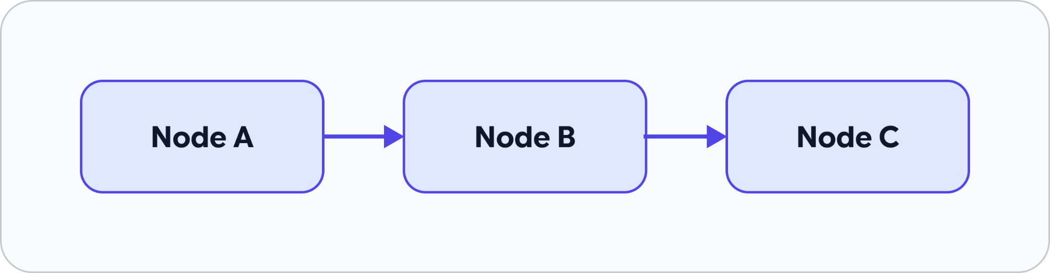
Sequential Chain
CHAINING & EXECUTION PATTERNS
A Sequential Chain represents a linear, deterministic pipeline in which processing steps, represented as nodes, are executed in a fixed order.
The output of one step becomes the input to the next.

Slide 27
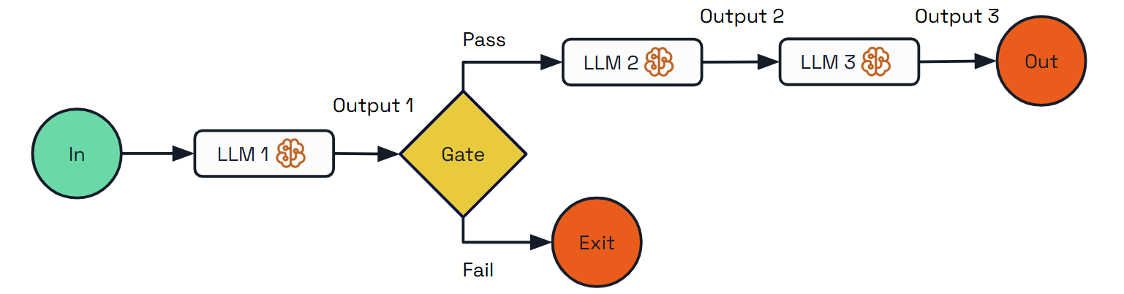
Sequential Chain
CHAINING & EXECUTION PATTERNS
The structured output of Step N becomes the direct input or context for Step N+1.
What is Gate? - Gate acts as a conditional decision point (or router) that evaluates "Output 1" from LLM 1:

Slide 28
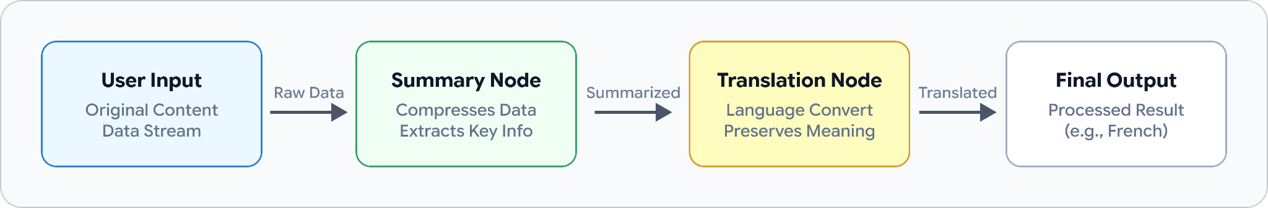
Sequential Chain (cont)
CHAINING & EXECUTION PATTERNS
Best Use Cases: Sequential execution works best for highly structured and predictable processes where each step depends on the result of the previous step.
Example: User asks: "Summarize this article and translate it into Khmer."
The workflow can be broken into:
  Step 1: Receive the user's article
  Step 2: LLM summarizes the article
  Step 3: LLM translates the summary into Khmer
  Final Output: Khmer summary

Slide 29
Sequential Chain (cont)
CHAINING & EXECUTION PATTERNS
Why Use Sequential Chains?
By decomposing a complex task into a sequence of small, focused steps, we can:
  Reduce task complexity: Each LLM call focuses on one specific task.
  Improve reliability: Individual steps can be constrained and validated.
  Improve debugging: Each node can be tested independently.
  Enable targeted evaluation: We can identify which step causes an incorrect result.
  Improve maintainability: Individual nodes can be modified or replaced without redesigning the entire workflow.

Slide 30
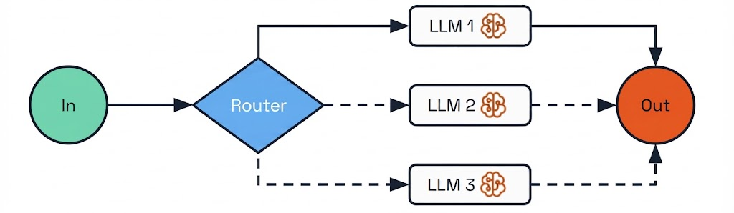
Conditional Routing
CHAINING & EXECUTION PATTERNS
Conditional Routing incorporates “if-then” branching logic into a workflow to determine the next step based on previous responses, conditions, decisions, or the current state.
It is a branching workflow pattern in which the execution path is determined dynamically at runtime.
Instead of sending every input through the same sequence of nodes, a router, classifier, or conditional function evaluates the current state and directs execution to the appropriate specialized path.

Slide 31
Conditional Routing (cont)
CHAINING & EXECUTION PATTERNS
The router acts as a decision point rather than performing the main computation itself. In a state-based workflow, the router evaluates the updated state produced by the preceding node and determines which node or branch should execute next.
When to use it: Conditional Routing is useful when an application handles multiple distinct types of requests that require different prompts, tools, processing strategies, or domain expertise.
It works particularly well for:
  Decision-based tasks where different conditions require different actions, such as customer service automation.
  Scenario-based problem solving where different approaches may be needed depending on the user's request.
  Multi-domain applications where different types of questions require specialized knowledge or tools.
  Flexible AI applications that need to handle a wide range of inputs and scenarios dynamically.

Slide 32
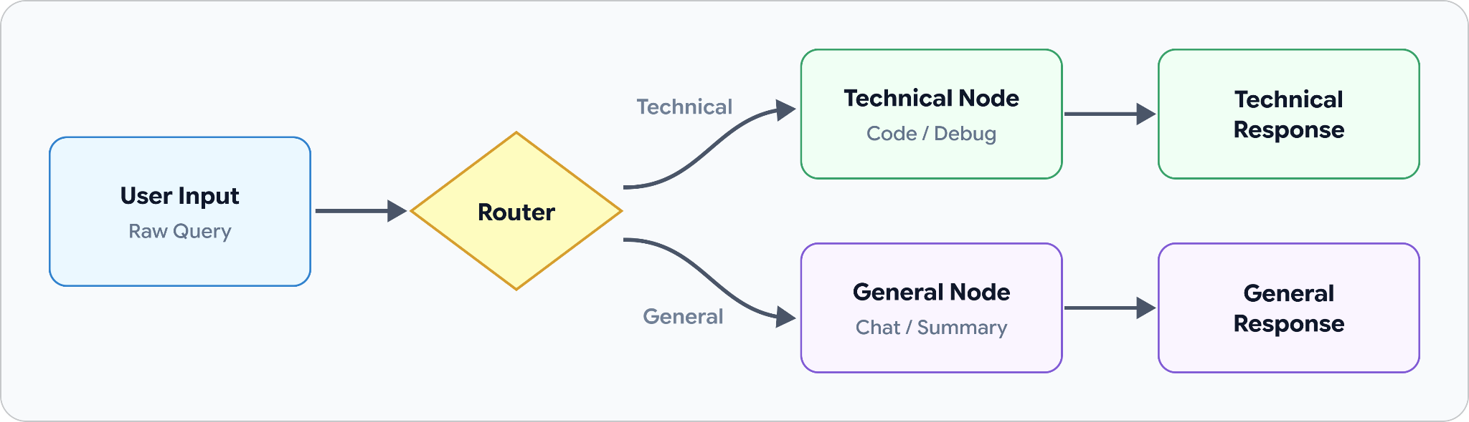
Conditional Routing (cont)
CHAINING & EXECUTION PATTERNS
For example: User asks: “Explain how to implement authentication in Spring Boot.”
  The router analyzes the request:
  If the request is identified as a technical question, it is routed to the Technical Node. Otherwise, it is routed to the General Node.

Slide 33
Conditional Routing (cont)
CHAINING & EXECUTION PATTERNS
Real-World Use Case: Customer Service
  Consider an AI customer service application that handles different types of product-related questions.
┌→ Pricing Flow
├→ Refund Flow
User Request → Router ───┼→ Return Flow
└→ Product Info Flow
  The workflow first classifies the user's request and then routes it to the specialized process:
    “How much does this product cost?” → Pricing Flow
    “I want my money back.” → Refund Flow
    “How can I return this product?” → Return Flow
    “What are the features of this product?” → Product Information Flow
  This allows the application to define specialized workflows for different scenarios, rather than forcing every request through the same processing pipeline.

Slide 34
03
Managing State,
and Memory
An overview of state and memory management, covering their differences, state management, why they are essential, and key techniques for maintaining context and persistence in LLM workflows.

Slide 35
What is State?
MANAGING STATE, MEMORY, AND PERSISTENCE
State is used to store short-term context information during a conversation.
It contains the information required to understand what is happening now and to continue execution from the current point.
Typical state includes:
  Current user inputs
  Intermediate results
  Tool outputs
  Variables and parameters
  Current workflow step
  Previous messages needed for the current task

Slide 36
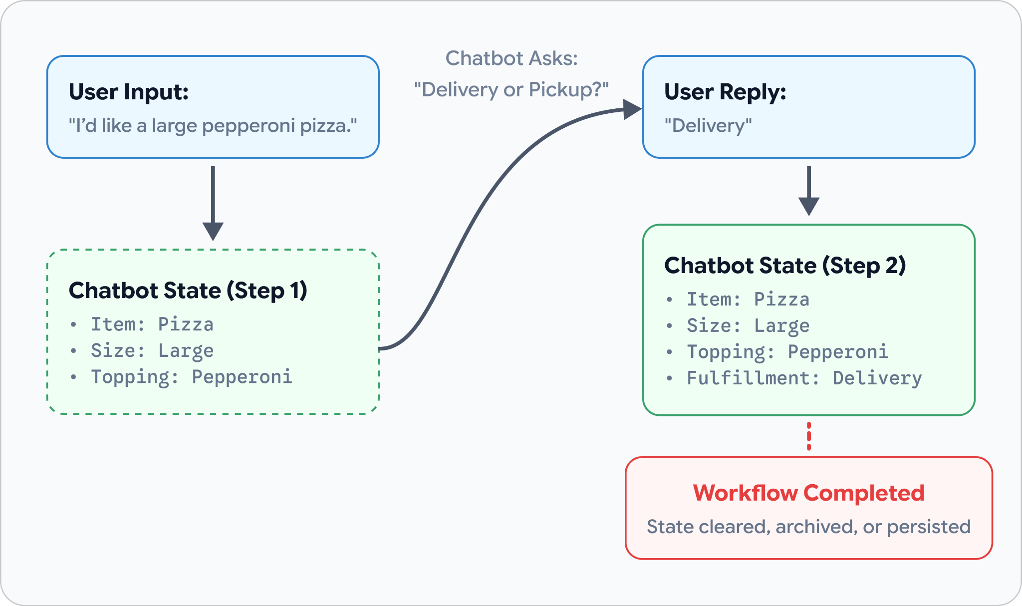
What is State?
MANAGING STATE, MEMORY, AND PERSISTENCE
Example — Ordering food through a chatbot.

Slide 37
What is State?
MANAGING STATE, MEMORY, AND PERSISTENCE
Example — Ordering food through a chatbot.
  User: "I’d like a large pepperoni pizza."
  The chatbot stores in its state: Item: Pizza, Size: Large, Topping: Pepperoni
  The chatbot then asks: "Would you like that for delivery or pickup?"
  The state is updated: Item: Pizza, Size: Large, Topping: Pepperoni, Fulfillment: Delivery
  Once the workflow is completed, this task-specific state may be cleared, archived, or persisted depending on the application design.

Slide 38
Memory
MANAGING STATE, MEMORY, AND PERSISTENCE
Memory is the long-term context memory in a conversational system.
It records a user's long-term preferences, habits, or historical data.
The data may be persisted and utilized across multiple sessions.
Example: The same food delivery chatbot remembering your habits.
  Over multiple sessions, the chatbot may remember:
Favorite Pizza: Pepperoni
Preferred Size: Large
Preferred Fulfillment: Delivery
  When the user returns later, the chatbot can use this information without asking again. the chatbot already knows: "User's favorite pizza is pepperoni," and "User always chooses delivery to 123 Main Street."
  It doesn't clear this data when the chat ends; it saves it so you don't have to re-type your preferences next time.

Slide 39
State vs. Memory - Comparison Table
MANAGING STATE, MEMORY, AND PERSISTENCE
Attribute | State | Memory
Time Horizon | Short-term / current execution | Long-term / across executions
Purpose | Manage the current task and workflow | Retain useful information for future use
Scope | Current task, session, or workflow | Multiple sessions or tasks
Content | Inputs, variables, intermediate results, tool outputs, workflow status | Preferences, history, persistent facts, past interactions
Lifecycle | Often temporary, but may be persisted | Intentionally retained
Example | Current pizza order: size, topping, delivery option | User's favorite pizza and usual delivery preference

Slide 40
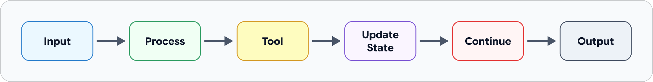
State Management
MANAGING STATE, MEMORY, AND PERSISTENCE
State management is the practice of organizing, updating, tracking, and controlling the information required to maintain an application's current execution context.
In an LLM application, state allows the system to:
This is especially important for multi-step LLM workflows and agentic systems, where the application needs to know what has already happened and what should happen next.

Slide 41
Why Managing Memory & State is Essential
MANAGING STATE, MEMORY, AND PERSISTENCE
Effective state and memory management helps LLM applications maintain consistency, continuity, efficiency, and recoverability.
Without proper management:
  Users may need to repeat information
  The application may lose important context
  The LLM may make inconsistent decisions
  The system may repeatedly process the same information
  Token usage and computational costs may increase
  Multi-step workflows may become difficult to resume or recover (if step 3 fails, you restart from step 1)
  Long-running tasks become harder to manage

Slide 42
Why Managing Memory & State is Essential
MANAGING STATE, MEMORY, AND PERSISTENCE
With proper management:
  State → keeps the current workflow coherent
  Memory → provides useful historical context
  Persistence → allows information to survive beyond the current execution
  Checkpoint → allows workflows to resume after interruption or failure

Slide 43
04
Document
Ingestion Pipelines
An overview of document ingestion, its role in bringing external data into LLM workflows, and the key stages of the document ingestion lifecycle.

Slide 44
What is Document Ingestion?
DOCUMENT INGESTION PIPELINES
Document Ingestion is the process of collecting documents from external sources and transforming them into clean, structured, chunked, embedded, and searchable fomat that an LLM can retrieve and use as external knowledge.
Examples of input documents:
  PDF, Word / DOCX, CSV / Excel
  Web pages
  Markdown
  Images and scanned documents
  Research papers
  Company knowledge bases
Instead of sending an entire document directly to an LLM, the ingestion process prepares the document so that only the most relevant information can be retrieved when needed.

Slide 45
Why Workflows Need External Data
DOCUMENT INGESTION PIPELINES
An LLM is powerful, but its internal knowledge is limited by its training. An LLM can reason over the information provided to it, but it does not automatically have access to an organization's private or newly created documents.
It cannot automatically know:
  Your company's internal documents
  Research papers uploaded yesterday
  Private databases
  Product manuals
  University regulations
  Real-time business information

Slide 46
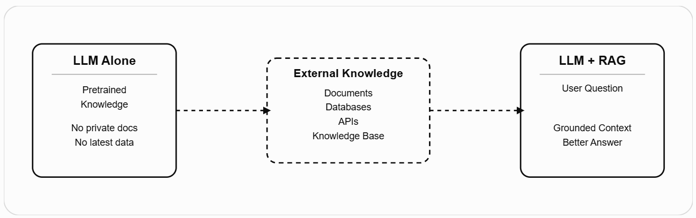
Why Workflows Need External Data
DOCUMENT INGESTION PIPELINES
Therefore, workflows need external data, and the Document Ingestion Pipeline plays an important role by transforming raw files into a searchable database.

Slide 47
Why Do LLM Workflows Need Document Ingestion?
DOCUMENT INGESTION PIPELINES
Real-world documents may contain:
  Too much irrelevant information
  Complex formatting and layouts
  Tables, images, and scanned content
  Repeated or duplicated information
  Very long sections
  Poorly structured text
Simply providing the entire document to an LLM creates several problems:
  High cost — unnecessary tokens increase inference costs.
  Slow processing — large contexts take longer to process.
  Limited scalability — sending entire documents does not scale well as the knowledge base grows.
  Poor retrieval — the LLM may receive too much information instead of the specific information needed.
  Context overload — irrelevant content can distract the model from the important information.

Slide 48
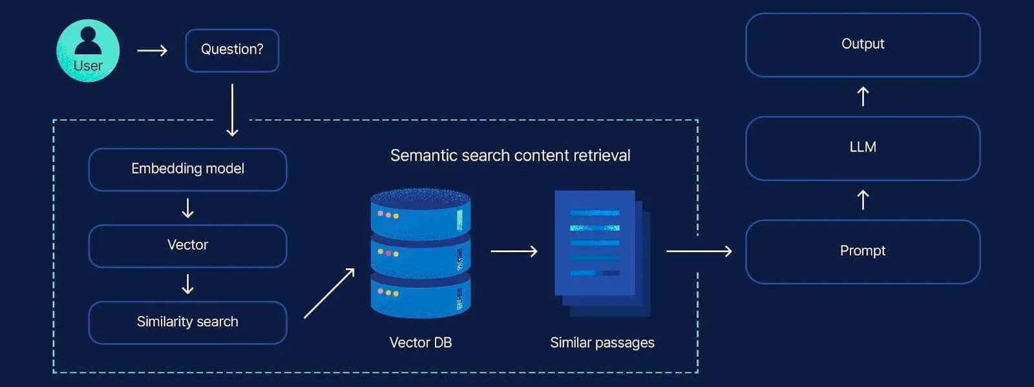
Why Do LLM Workflows Need Document Ingestion?
DOCUMENT INGESTION PIPELINES
Therefore,
  Problem: Raw documents are large, unstructured, and not directly optimized for LLM retrieval.
  Solution: Document Ingestion transforms raw documents into structured, searchable knowledge that can be efficiently retrieved and provided to the LLM as context.

Slide 49
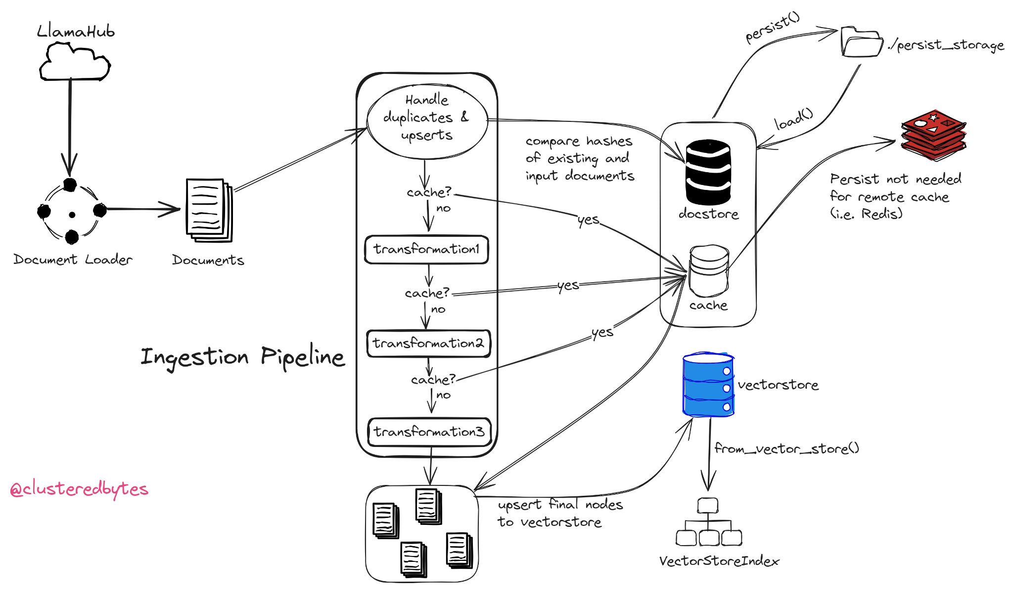
The Ingestion Lifecycle
DOCUMENT INGESTION PIPELINES
  Loading: Where does the data come from?
  Check Cache: Does it need to be processed again?
  Transformations: How do we make it retrieval-ready?
  Storage: Where do we keep it for retrieval?

Slide 50
The Ingestion Lifecycle
DOCUMENT INGESTION PIPELINES
Step 1: Loading
  Raw files such as PDFs, text documents, CSVs, or external data sources are loaded through data connectors/readers such as SimpleDirectoryReader.
  The data is converted into standardized LlamaIndex Document objects, containing the document text and metadata.
  Assigning deterministic document identifiers, such as filename_as_id=True, helps the pipeline consistently identify the same source document across ingestion runs.
  Output: Raw Files → Document Objects

Slide 51
The Ingestion Lifecycle
DOCUMENT INGESTION PIPELINES
Step 2: Check Cache/Hash via Docstore
  Before performing expensive operations such as chunking, metadata extraction, and embedding generation, the pipeline checks whether the document has already been processed.
  The pipeline checks the attached docstore (document store), which maintains information about previously processed documents/nodes.
  It maps each document’s unique ID (doc_id) to a cryptographic content hash. The content hash is used to determine whether a document is unchanged or has been modified.
    If a file’s hash matches an existing record in the docstore, the file has not changed. The pipeline therefore skips processing it entirely, allowing the existing data to be reused.
    If the file is new or its content has changed, it will have a new hash. The file is then flagged for processing and proceeds through the transformation pipeline.
  Purpose: Avoid unnecessary processing and embedding computation.
  Output:
Unchanged → Reuse / Skip
New or Modified → Process

Slide 52
The Ingestion Lifecycle
DOCUMENT INGESTION PIPELINES
Step 3: Run Transformations (Chunking / Metadata / Embedding)
  New or modified documents pass through a sequence of transformations defined in the IngestionPipeline.
  The Sub-Stages:
    Chunking
    Metadata Extraction
    Embedding Generation

Slide 53
The Ingestion Lifecycle
DOCUMENT INGESTION PIPELINES
Step 3: Run Transformations (Chunking / Metadata / Embedding)
  The Sub-Stages:
    Chunking:
      Long documents are divided into smaller units called Chunks.
      Modules like SentenceSplitter chop long documents into smaller structural pieces called Nodes.
      Chunking makes individual passages easier to retrieve and fit into the LLM's context window.

Slide 54
The Ingestion Lifecycle
DOCUMENT INGESTION PIPELINES
Step 3: Run Transformations (Chunking / Metadata / Embedding)
  The Sub-Stages (cont)
    Metadata Extraction:
      Optional transformations can enrich nodes with additional information such as:
        Titles
        Keywords
        Summaries
        Entities
        Source information
      This metadata can later support filtering and retrieval.

Slide 55
The Ingestion Lifecycle
DOCUMENT INGESTION PIPELINES
Step 3: Run Transformations (Chunking / Metadata / Embedding)
  The Sub-Stages (cont)
    Embedding Generation:
      Each text chunk is converted into a numerical vector representation using an embedding model (e.g., OpenAI or HuggingFace).
"Document ingestion is..."
↓
Embedding Model
↓
[0.12, -0.43, 0.87, ...]
      These vectors capture semantic information that enables similarity-based retrieval.

Slide 56
The Ingestion Lifecycle
DOCUMENT INGESTION PIPELINES
Step 4: Save to Vector Store (Persistence & Upserts)
  The processed chunks, including their text, metadata, and vector embeddings, are stored for later retrieval.
  Depending on the architecture, they may be stored in:
    A vector database
    A document store
    Local persistent storage
    A remote database
  How it finishes:
    If a vector store is attached to the pipeline, it handles upserts (inserting new nodes or replacing outdated ones if a document changed).
    You can persist the document state locally (using .persist()) or to a remote database cache so future runs remain fast and cost-effective.

Slide 57
05
Modular
Workflow Design
Understanding the four architectural layers of an LLM application (Model, Orchestration, Data, Observability and Guardrail) and the principles that make components swappable and reusable, single responsibility, standard interfaces, and composability.

Slide 58
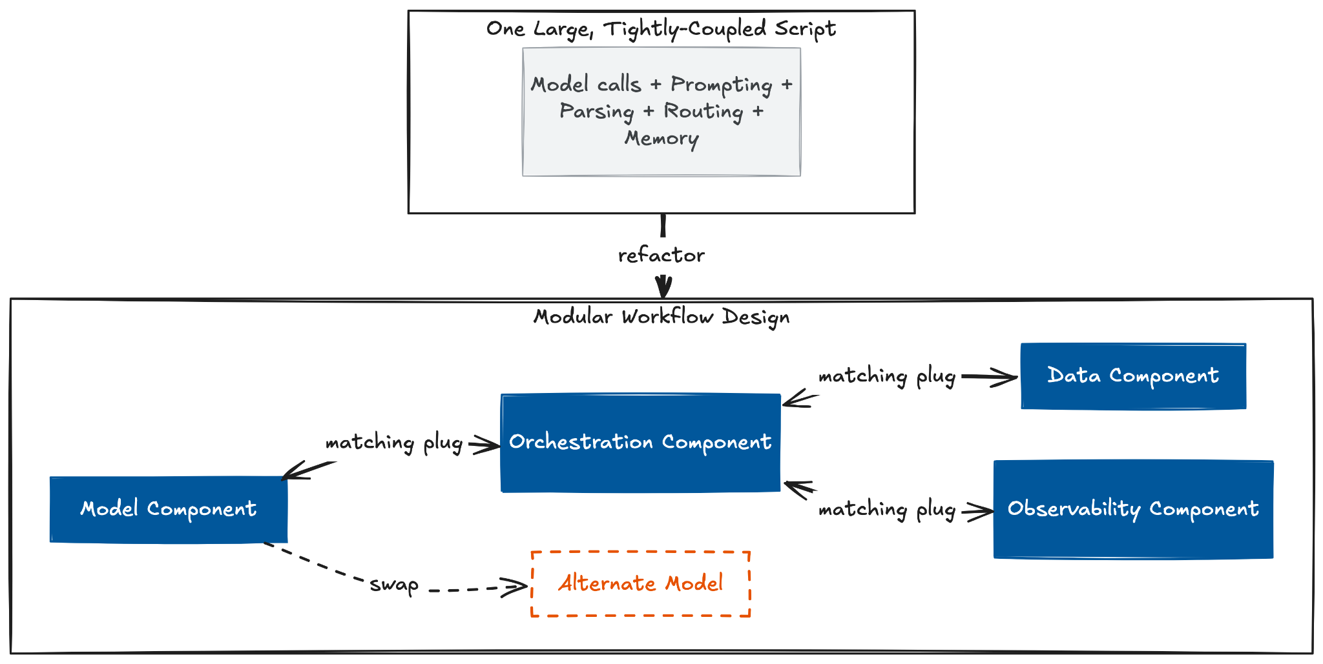
What is Modular Workflow Design?
Modular Workflow Design
Modular workflow design is the practice of building an LLM application as small, independently swappable pieces, connected through standard interfaces, rather than one large, tightly-coupled script.

Slide 59
The Four Layers of an LLM Application
Modular Workflow Design
This 4 layers modularity applied at the scale of the whole system, each layer is a single responsibility, just a much bigger one than any single function's. Splitting by layer before ever splitting by individual component is what keeps a change to one job, swapping a model, tightening a guardrail, from forcing a change everywhere else.
  Model Layer: how the application accesses a model. It should be a replaceable component, not a hard dependency, swapping providers shouldn't touch anything else in the system.
  Orchestration Layer: routing, sequencing, and state management across multi-step interactions, the layer deciding what happens next.
  Data Layer: how the application retrieves and prepares context, documents, embeddings, anything the model needs but doesn't already know.
  Observability and Guardrail Layer: tracing, logging, hallucination detection, safety enforcement, output validation.

Slide 60
Principles of Modular Design
Modular Workflow Design
An LLM Application that consider as modular should follow the 3 principles as below:
  Single responsibility: Each piece should do exactly one job. A function that configures a model shouldn't also handle prompts or parsing. A schema that defines a valid answer shouldn't know how that answer gets generated. A piece with only one reason to change can be changed without affecting anything else.
  Standard interfaces: A piece can only be swapped out if the code around it doesn't depend on which specific version it's using. If every model in a system responds to a call the same way, replacing one model with another becomes a one-line change instead of a rewrite.
  Composability: Small pieces combine into bigger workflows without extra connecting code, because they already share the same interface. Linking two pieces together, through a pipe, an edge, any connection, works simply because both sides were already built to the same shared format.

Slide 61


06
Orchestration
Framework
Three framework for building multi-step LLM workflows, LangChain handles linear workflows and prompt orchestration, LangGraph manages complex stateful routing and memory, and LlamaIndex powers data ingestion and indexing.

Slide 62
LlamaIndex
Orchestration Framework: LlamaIndex
LlamaIndex is a data framework designed to connect custom and private data sources (such as PDFs, databases, APIs, and unstructured files) to Large Language Models (LLMs). Its primary purpose is to simplify the end-to-end development of Retrieval-Augmented Generation (RAG) applications, search interfaces, and data-driven AI agents.

Slide 63
Key Components
Orchestration Framework: LlamaIndex
These five components work together as a pipeline raw data comes in through Data Connectors, gets restructured into Nodes, organized into a searchable Index, and made retrievable through Retrievers and Query Engines.
  Data Connectors: Ingest raw data from diverse sources (PDFs, SQL databases, cloud storage, API endpoints) and convert it into standardized Document objects while extracting basic text and metadata.
  Nodes: Chunked, structured fragments derived from Document objects. They represent the fundamental atomic units of data stored, embedded, and fetched during a query, maintaining relationships to parent documents and adjacent chunks.
  Indices: Searchable data structures that organize Nodes to enable efficient retrieval. They structure data based on the intended search pattern, such as vector indices for semantic similarity, keyword indices for exact matching, or summary structures for hierarchical analysis.

Slide 64
Key Components (cont)
Orchestration Framework: LlamaIndex
  Retrievers: Query execution modules that select the most relevant Nodes from an index. They apply specific search strategies based on the index type, including vector embedding comparisons, keyword filtering, BM25 matching, or hybrid approaches.
  Query Engines: Top-level pipeline orchestrators that manage the full RAG interaction. They route the user's prompt to the Retriever, collect the returned context Nodes, optionally perform post-processing (like reranking), and prompt the LLM to generate a grounded response.

Slide 65

Key Components (cont)
Orchestration Framework: LlamaIndex

Slide 66
Document Ingestion Workflow with LlamaIndex
Orchestration Framework: LlamaIndex
Document ingestion is the offline half of the workflow, three stages that turn raw files into a queryable index before any user ever asks a question.
  Loading: Connectors fetch your raw files (PDFs, databases, web pages, APIs) and convert them all into a standard "Document" format.
  Transformations:
    Documents are split into Nodes by a Node Parser.
    Metadata extraction and Embedding are both optional, embedding specifically is only needed if the Index ahead relies on semantic search.
  Indexing: The resulting Nodes are organized into an Index shaped for the intended search pattern, semantic similarity, keyword matching, or summary, depending on the index type chosen.
  Persisting & Loading Data: The finished Index is saved to a disk or database based on your index type, so your system doesn't have to reprocess all your data every time the app launches. This completes the data ingestion process.

Slide 67
Required Package
Orchestration Framework: LlamaIndex
These are the minimum package you need to install to get your LlamaIndex working
llama-index-core - the framework itself
llama-index-llms-openai-like - lets Settings.llm talk to vLLM's /v1/chat/completions endpoint
llama-index-embeddings-openai-like - lets Settings.embed_model talk to vLLM's /v1/embeddings endpoint
llama-index-readers-file - adds the file-type-specific readers SimpleDirectoryReader dispatches to (PDF, DOCX, and so on)
pip install llama-index-core \ llama-index-llms-openai-like \ llama-index-embeddings-openai-like \ llama-index-readers-file

Slide 68
Setting Up Model
Orchestration Framework: LlamaIndex
Global Model Configuration Setup with Settings
  Settings is a global object LlamaIndex reads from by default, set it once, and every index, retriever, and query engine built afterward uses it automatically, no need to pass the model into each one individually.
from llama_index.core import Settings
from llama_index.llms.openai_like import OpenAILike
from llama_index.embeddings.openai_like import OpenAILikeEmbedding
Settings.llm = OpenAILike(
model="Qwen/Qwen2.5-7B-Instruct",
api_base="http://localhost:8000/v1",
api_key="VLLM",
context_window=32768,
is_chat_model=True,
)
Settings.embed_model = OpenAILikeEmbedding(
model_name="nomic-embed-text:latest",
api_base="http://localhost:8000/v1",
api_key="VLLM",
embed_batch_size=10,
)

Slide 69
Setting Up Model (cont)
Orchestration Framework: LlamaIndex
Global Model Configuration Setup with Settings (cont.)
model / model_name - match the model vLLM or ollama
api_base - the server's URL, ending in /v1
context_window=32768 - defaults to 3900, change this to fit the model you’re using
is_chat_model=True - sends requests to /chat/completions
api_key="EMPTY" - a placeholder, vLLM ignores it
embed_batch_size=10 - how many texts get embedded per request (default 10)

Slide 70
Data Connector
Orchestration Framework: LlamaIndex
SimpleDirectoryReader is the default connector for a local folder, point it at a directory and it returns a list[Document], one entry per file.
  recursive=True also loads files in subfolders, off by default
  required_exts restricts loading to specific file types, default to load every file type SimpleDirectoryReader recognizes such as .pdf, .docx, .ppt, .pptm, .pptx, .csv, .md, etc.
Note:
SimpleDirectoryReader handles local folders by default, and all data connectors output the exact same format (list[Document]).
LlamaHub Integrations: Hundreds of individual, package-based readers are available through LlamaHub to ingest data from third-party platforms (e.g., Notion, Slack, Google Drive, S3).
from llama_index.core import SimpleDirectoryReader
documents = SimpleDirectoryReader(
"./workflow-engineering/llama-index/data",
recursive=True,
required_exts=[".pdf", ".md"],
).load_data()

Slide 71
Transformation & Indexing
Orchestration Framework: LlamaIndex
In llamaIndex there are several way you can implement this step:
Manual transformation with SentenceSplitter(), split then Index
Using IngestionPipeline(), split then index
Using index_type.from_documents(), split and index
VectorStoreIndex is the default for semantic search, but it's one of several index types LlamaIndex can build from the same Nodes:
Index type | Best for
VectorStoreIndex | Semantic similarity search
SummaryIndex | Small datasets, sends every Node to the LLM
KeywordTableIndex | Exact keyword matching

Slide 72
Transformation & Indexing (cont)
Orchestration Framework: LlamaIndex
Manual transformation, split then Index
from llama_index.core import VectorStoreIndex
from llama_index.core.node_parser import SentenceSplitter
from llama_index.core.extractors import TitleExtractor
#Splitting the document into nodes
splitter = SentenceSplitter(chunk_size=512, chunk_overlap=50)
nodes = splitter.get_nodes_from_documents(documents)
#Optional adding metadata
title_extractor = TitleExtractor(nodes=5, llm=Settings.llm)
nodes = title_extractor(nodes)
#Optional Embedding based on storing in this case embed and store in In-Memory Vector Store
for node in nodes:
node.embedding = Settings.embed_model.get_text_embedding(node.get_content())
index = VectorStoreIndex(nodes)

Slide 73
Transformation & Indexing (cont)
Orchestration Framework: LlamaIndex
Manual transformation, split then Index (cont.)
SentenceSplitter turns Documents into Nodes. chunk_size sets max tokens per Node (default 1024); chunk_overlap (default 200) repeats that many tokens at the end of one Node and the start of the next, so a sentence split across the cut point still appears whole in at least one Node instead of being torn in half
TitleExtractor reads the first few Nodes of a Document (nodes) to guess a title using a chosen model (llm), then writes that one title onto every Node from that Document, including ones it never read. One LLM call per Document, not per Node, that's why it's cheap enough to leave on by default.
VectorStoreIndex() builds a searchable vector index directly from the already-embedded Nodes and stored entirely on RAM.

Slide 74
Transformation & Indexing (cont)
Orchestration Framework: LlamaIndex
Using IngestionPipeline(), split then index
from llama_index.core.ingestion import IngestionPipeline, IngestionCache
from llama_index.core.storage.docstore import SimpleDocumentStore
pipeline = IngestionPipeline(
transformations=[
SentenceSplitter(chunk_size=512, chunk_overlap=50),
TitleExtractor(nodes=5, llm=Settings.llm),
Settings.embed_model,
],
)
nodes = pipeline.run(documents=documents, show_progress=True)
index = VectorStoreIndex(nodes)

Slide 75
Transformation & Indexing (cont)
Orchestration Framework: LlamaIndex
Using index_type.from_documents()
VectorStoreIndex.from_documents(documents) combine splitting, embedding and indexing in one call.
This single line replaces the Transformations → Indexing into one step having defaults to SentenceSplitter(chunk_size=1024, chunk_overlap=200).
#Combine Splitting and Embedding into one step.
index = VectorStoreIndex.from_documents(
documents,
#transformations is optional
transformations=[
SentenceSplitter(chunk_size=512, chunk_overlap=50),
TitleExtractor(nodes=5, llm=Settings.llm),
],
)

Slide 76
Persisting and Loading Data
Orchestration Framework: LlamaIndex
Persisting and Loading Data
persist() writes the docstore, index store, and vector store, the in-memory SimpleVectorStore used here, to JSON files in persist_dir
from llama_index.core import StorageContext, load_index_from_storage
storage_context = StorageContext.from_defaults(persist_dir="./workflow-engineering/llama-index/storage")
index = load_index_from_storage(storage_context)

Slide 77
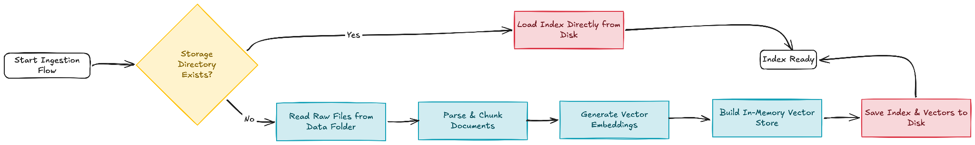
Putting Everything Together
Orchestration Framework: LlamaIndex
This code ingest file .md from a local folder and the flow goes:
  checks whether a persisted index already exists
  if not: loads documents, builds the index, and persists it, prints how many documents it processed
  if it already exists: loads it directly from disk instead, no re-reading files, no re-embedding, prints that it skipped reprocessing
  runs one small, explicitly-marked retrieval check
Github Link

Slide 78
LangChain
Orchestration Framework: LangChain
LangChain is a toolkit that makes it easy to build AI-powered apps. Instead of writing complex code from scratch to connect your app to an AI model, LangChain gives you pre-built, swappable pieces for standard tasks:
  Formatting prompts
  Calling the AI model
  Parsing outputs
  Adding tools
Because these pieces are standardized, you can switch between different AI providers, like running a free model on your computer or using a paid cloud service, by changing just one line of code.

Slide 79
Key Components
Orchestration Framework: LangChain
These five components work together as a pipeline raw data comes in through Data Connectors, gets restructured into Nodes, organized into a searchable Index, and made retrievable through Retrievers and Query Engines.
  Chat Models: A unified wrapper (ChatOpenAI, and equivalents for every provider) over any chat completions endpoint, including a local vLLM server's OpenAI-compatible API.
  Messages: Typed conversation turns (HumanMessage, SystemMessage, AIMessage) that represent one exchange in a chat, the unit chat models actually consume and return.
  Prompt Templates: Parameterized prompt strings (ChatPromptTemplate) with named {variables} filled in at call time, instead of hand-formatting strings.
  Output Parsers: Convert a model's raw response into a usable Python type, a plain string, a JSON dict, or a validated Pydantic object.
  Runnables & Chain: Runnable is the shared interface (invoke, batch, stream) every component above implements. A Chain is what you get piping Runnables together with the | operator.

Slide 80
Required Package
Orchestration Framework: LangChain
These are the minimum package you need to install to get your LangChain working
  langchain: the high-level package, holds init_chat_model and the agent-building utilities.
  langchain-openai: lets LangChain talk to any OpenAI-compatible endpoint, including a local vLLM server's /v1/chat/completions.
  langchain-core: the foundation every other package builds on, holds the Runnable interface, prompt templates, messages, and output parsers.
  pydantic: schema validation for structured output, pinned to match the course's version target.
pip install langchain langchain-openai langchain-core pydantic

Slide 81
Chat Models
Orchestration Framework: LangChain
There are 2 main ways to initialize a chat model in LangChain using:
  Provider Subclass: A unified wrapper (ChatOpenAI, and equivalents for every provider) over any chat completions endpoint, including a local vLLM server's OpenAI-compatible API.
  init_chat_model: builds a chat model from one string, "provider:model-name", instead of importing a provider-specific class. Extra keyword arguments (base_url, api_key, temperature, and so on) pass straight through to that provider's constructor.

Slide 82
Chat Models (cont)
Orchestration Framework: LangChain
Provider SubClass with ChatOpenAI
  Example:
from langchain_openai import ChatOpenAI
llm = ChatOpenAI(
model="Qwen/Qwen2.5-7B-Instruct",
base_url="http://localhost:8000/v1",
api_key="EMPTY",
)

Slide 83
Chat Models (cont)
Orchestration Framework: LangChain
init_chat_model()
  Example:
from langchain.chat_models import init_chat_model
llm = init_chat_model(
"openai:Qwen/Qwen2.5-7B-Instruct",
base_url="http://localhost:8000/v1",
api_key="EMPTY",
temperature=0,
)
the "openai:" prefix picks the provider constructor, vLLM speaks the OpenAI protocol, so this is the prefix to use for any self-hosted OpenAI-compatible server.
other providers (anthropic, google_vertexai, cohere, and more) get inferred automatically from common name prefixes (claude*, gpt-*) when left off, that inference doesn't cover custom local model names.

Slide 84
Messages
Orchestration Framework: LangChain
Every chat model consumes and returns a list of typed message objects, not raw strings, each one tagged with a role that tells the model who is speaking.
  SystemMessage sets persistent instructions and persona, sent once at the start of the list
  HumanMessage and AIMessage alternate to represent the back-and-forth of a conversation, AIMessage is what .invoke() returns
  ToolMessage carries a tool's result back to the model after a tool call, its tool_call_id must match the id on the AIMessage that requested it

Slide 85
Messages (cont)
Orchestration Framework: LangChain
Example:
from langchain_core.messages import SystemMessage, HumanMessage, AIMessage
messages = [
SystemMessage("You are a concise technical assistant."),
HumanMessage("Name one advantage of PagedAttention."),
AIMessage("It avoids memory fragmentation in the KV cache."),
HumanMessage("How does that compare to naive allocation?"),
]

Slide 86
Prompt Templates & Structure Inputs
Orchestration Framework: LangChain
A ChatPromptTemplate defines a chat prompt with blanks in it. Each {variable} gets filled in when you call it, so the same template gets reused with different values instead of writing a new prompt string every time.
from langchain_core.prompts import ChatPromptTemplate
prompt = ChatPromptTemplate.from_messages([
("system", "You are a career coach specializing in {field}."),
("human", "{question}"),
])
from_messages accepts role tuples ("system", "human", "ai") or message objects, mixed freely.
The role tuples above are shorthand. Each one expands to an actual template class, SystemMessagePromptTemplate, HumanMessagePromptTemplate, AIMessagePromptTemplate

Slide 87
Prompt Templates & Structure Inputs (cont)
Orchestration Framework: LangChain
Chat History with MessagesPlaceholder, MessagesPlaceholder is a different kind of blank, it accepts a whole list of prior messages, the conversation history so far, and expands them into real message turns at that spot in the template.
from langchain_core.prompts import ChatPromptTemplate, MessagesPlaceholder
prompt = ChatPromptTemplate.from_messages([
("system", "You are a career coach specializing in {field}."),
MessagesPlaceholder("history", optional=True),
("human", "{question}"),
])

Slide 88
Output Parsers
Orchestration Framework: LangChain
Output Parsers turn a model's raw response into something your code can actually use, a plain string, or a validated object with real fields, instead of manual parsing every time.
  StrOutputParser(): extracts .content (plain text), mainly useful for clean string output at the end of a chain.
from langchain_core.output_parsers import StrOutputParser
from langchain_openai import ChatOpenAI
llm = ChatOpenAI(model="Qwen/Qwen2.5-7B-Instruct", base_url="http://localhost:8001/v1", api_key="EMPTY")
parser = StrOutputParser()
chain = llm | parser
print(chain.invoke("Say hello in five words."))

Slide 89
Output Parsers (cont)
Orchestration Framework: LangChain
  .with_structured_output(): It uses the model's native tool-calling or JSON-mode support to make the llm responses as JSON Format.
from pydantic import BaseModel, Field
from langchain.chat_models import init_chat_model
class Ticket(BaseModel):
category: str = Field(description="billing, technical, or general")
urgency: int = Field(description="1-5, 5 is most urgent")
llm = init_chat_model(model="openai:Qwen/Qwen2.5-7B-Instruct", base_url="http://localhost:8001/v1", api_key="EMPTY")
structured = llm.with_structured_output(Ticket, method="json_schema")
print(structured.invoke("My invoice is wrong and I'm furious."))

Slide 90
Chain & Runnables
Orchestration Framework: LangChain
A Chain is a sequence of steps that links components like prompts, models, and parsers together.
It use Pipe Operator “ | ” to chain runnables together sequentially and each step’s output becomes the next step input, left to right.
from langchain_core.prompts import ChatPromptTemplate
from langchain_core.output_parsers import StrOutputParser
llm = init_chat_model(
model="openai:Qwen/Qwen2.5-7B-Instruct",
base_url="http://localhost:8000/v1",
api_key="EMPTY")
prompt = ChatPromptTemplate.from_template("Answer in one sentence: {question}")
chain = prompt | llm | StrOutputParser()
print(chain.invoke({"question": "What does vLLM serve at /v1?"}))

Slide 91
Chain & Runnables (cont)
Orchestration Framework: LangChain
Runnable is the base interface nearly every component implements, chat models, prompt templates, output parsers, all of them.
  invoke(input): run once, return the full result
  batch([inputs]): run several inputs, executed concurrently, return a list of results
  stream(input): return results incrementally as they're produced, instead of waiting for the whole thing

Slide 92
Chain & Runnables (cont)
Orchestration Framework: LangChain
Example:
from langchain.chat_models import init_chat_model
llm = init_chat_model(
model="openai:Qwen/Qwen2.5-7B-Instruct",
base_url="http://localhost:8000/v1",
api_key="EMPTY")
llm.invoke("Say hi") # one call, full result
llm.batch(["Say hi", "Say bye"]) # two calls, run concurrently
for chunk in llm.stream("Say hi"): # incremental output, chunk by chunk
print(chunk.content, end="")

Slide 93
Chain & Runnables (cont)
Orchestration Framework: LangChain
There are many more types of Runnable such as:
  RunnableParallel runs several Runnables on the same input at once and merges the results into a dict, instead of running them one after another.
  RunnableLambda: wraps a plain Python function.
  RunnablePassthrough: forwards the input through unchanged, useful when a later step needs the original input alongside something computed from it.
  RunnableBranch: routes to a different Runnable depending on the input.

Slide 94
Chain & Runnables (cont)
Orchestration Framework: LangChain
Example: RunnableParallel
from langchain_core.prompts import ChatPromptTemplate
from langchain_core.output_parsers import StrOutputParser
from langchain_core.runnables import RunnableParallel
joke_chain = ChatPromptTemplate.from_template("Tell me a short joke about {topic}") | llm | StrOutputParser()
poem_chain = ChatPromptTemplate.from_template("Write a two-line poem about {topic}") | llm | StrOutputParser()
parallel = RunnableParallel(joke=joke_chain, poem=poem_chain)
result = parallel.invoke({"topic": "bears"})
print(result) # {"joke": "...", "poem": "..."}, both generated concurrently

Slide 95
Chain & Runnables (cont)
Orchestration Framework: LangChain
Example: RunnableLamda
from langchain_core.runnables import RunnableLambda
def word_count(text: str) -> int:
return len(text.split())
counter = RunnableLambda(word_count)
counter.invoke("how many words is this") # 5

Slide 96
Chain & Runnables (cont)
Orchestration Framework: LangChain
Example: RunnablePassThrough
from langchain_core.runnables import RunnablePassthrough, RunnableLambda
word_count = RunnableLambda(lambda x: len(x["text"].split()))
chain = RunnablePassthrough.assign(word_count=word_count)
print(chain.invoke({"text": "how many words is this"}))

Slide 97
Chain & Runnables (cont)
Orchestration Framework: LangChain
Example: RunnableBranch
from langchain_core.prompts import ChatPromptTemplate
from langchain_core.output_parsers import StrOutputParser
from langchain_core.runnables import RunnableBranch
from langchain.chat_models import init_chat_model
llm = init_chat_model(
model="openai:Qwen/Qwen2.5-7B-Instruct",
base_url="http://localhost:8000/v1",
api_key="EMPTY")
billing_chain = ChatPromptTemplate.from_template("Answer this billing question: {input}") | llm | StrOutputParser()
technical_chain = ChatPromptTemplate.from_template("Answer this technical question: {input}") | llm | StrOutputParser()
general_chain = ChatPromptTemplate.from_template("Answer this question: {input}") | llm | StrOutputParser()

Slide 98
Chain & Runnables (cont)
Orchestration Framework: LangChain
Example: RunnableBranch
router = RunnableBranch(
(lambda x: "billing" in x["input"].lower(), billing_chain),
(lambda x: "technical" in x["input"].lower(), technical_chain),
general_chain, # default, runs if nothing above matched
)
print(router.invoke({"input": "My billing invoice is wrong"})) # routes to billing_chain

Slide 99
Chain & Runnables (cont)
Orchestration Framework: LangChain
Type | When to use it | Example
RunnableSequence | The default, most chains are just this | Format a prompt, call the model, parse the reply into JSON
RunnableParallel | Two or more steps that don't depend on each other's output | Generate a summary and a sentiment score from the same review at once
RunnablePassthrough | A later step needs the original input alongside something computed from it | Keep the original support ticket while adding a computed urgency score
RunnableLambda | Custom logic that isn't a model, prompt, or parser | Word-count or profanity-check a message before it reaches the model, Logging, Reshaping, etc.
RunnableBranch | The next step depends on what the input actually is, not just a transformation of it | Route a support ticket to a billing chain or a technical chain based on keywords

Slide 100
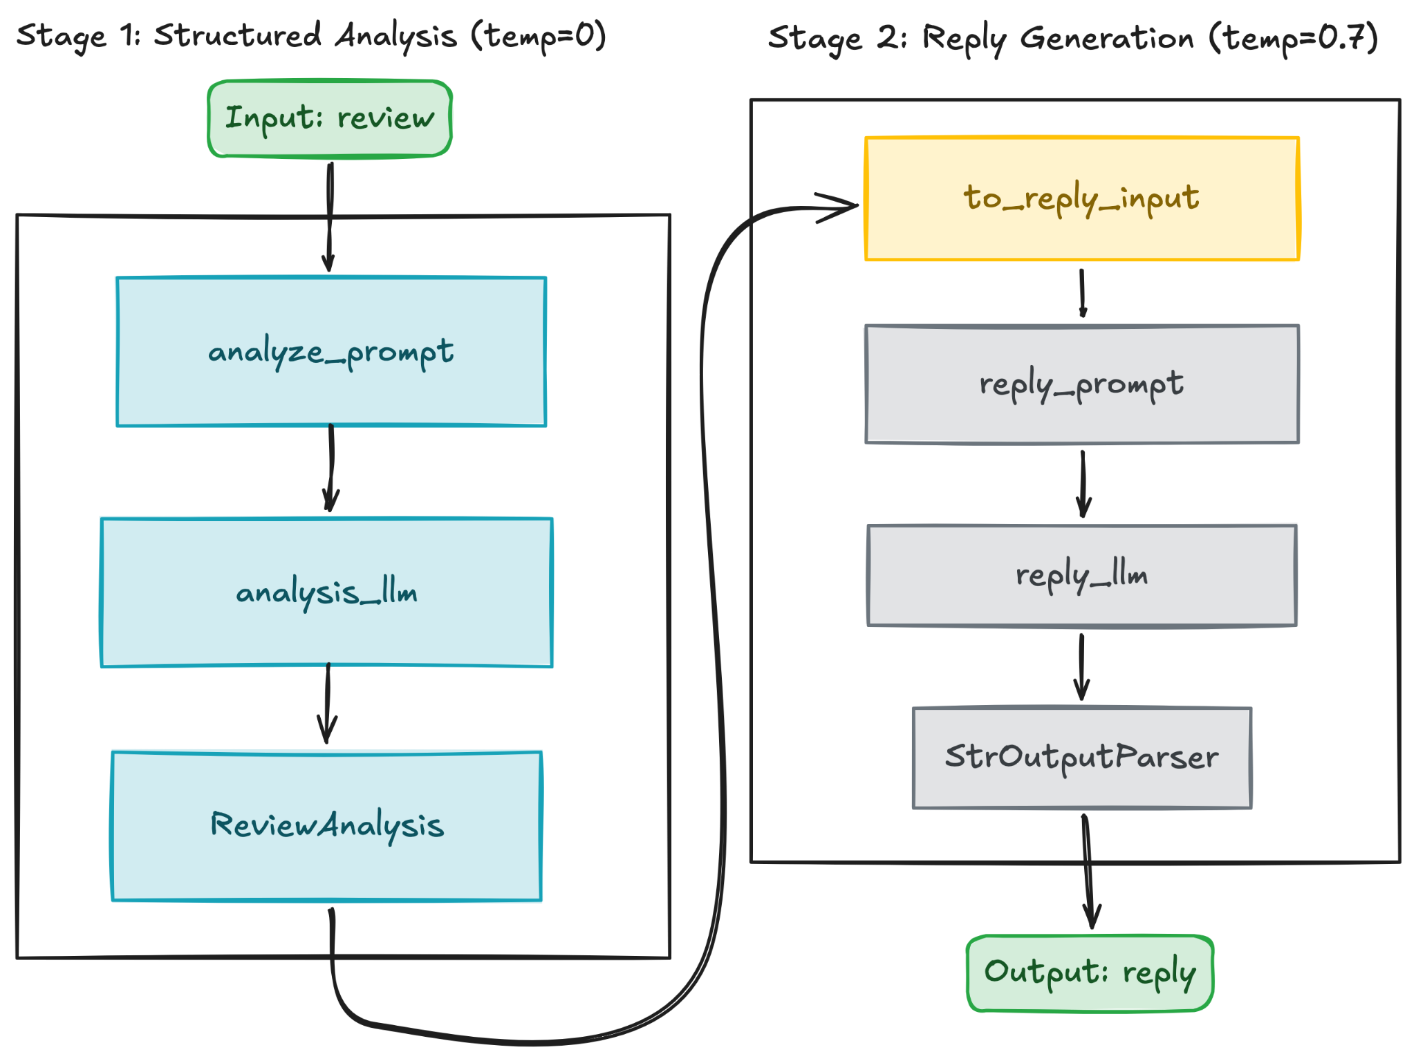
Putting Everything Together
Orchestration Framework: LangChain
This code builds a workflow for Customer Sentimental Analysis and Reply that:
  takes in a customer review
  analyzes it into structured fields (sentiment, main issue)
  drafts a short, empathetic reply informed by that analysis
  prints the final reply
Github Link

Slide 101
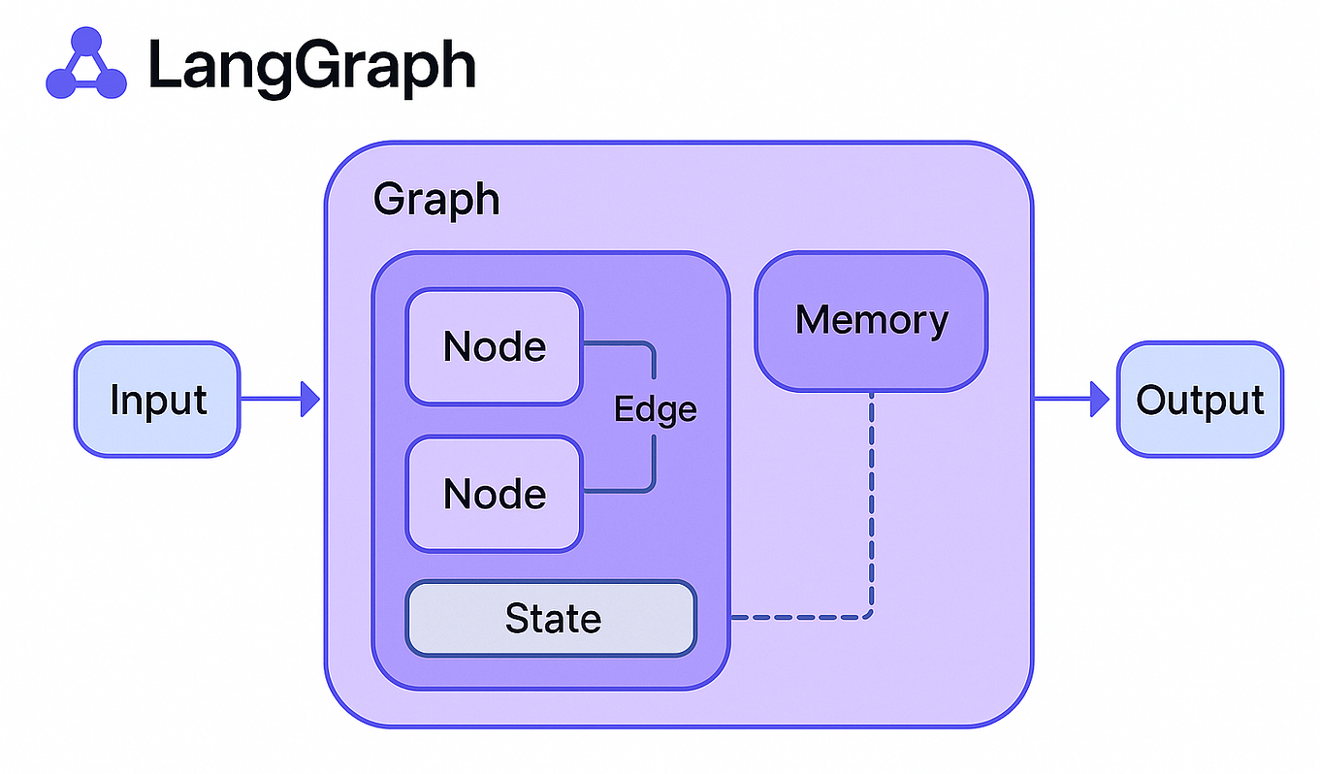
LangGraph
Orchestration Framework: LangGraph
LangGraph is a low-level orchestration framework for building stateful, long-running agents and workflows, built by LangChain Inc.
Why LangGraph?
  LangGraph add cycles (a node can loop back to an earlier node) and persistence (state survives across separate calls, not just within one) that LangChain does not have.

Slide 102
Key Components
Orchestration Framework: LangGraph
Every LangGraph application is built from the same handful of pieces, wired together into a graph and then compiled into something runnable.
  State: A shared data structure, typically a TypedDict, representing the current snapshot of the application. Every node reads from it and returns updates to it.
  Nodes: Plain Python functions that receive the current state and return a partial update. Nodes do the work.
  Edges: Connections between nodes that determine what runs next, either fixed or conditional on the current state. Edges decide what happens next.
  Compiled Graph: What builder.compile() produces, the actual runnable object, with the same invoke / stream / ainvoke shape as every Runnable from the LangChain lesson.
  Checkpointer: Persists the graph's state after every step, keyed by a thread_id, so a conversation or workflow can pause and resume exactly where it left off.

Slide 103
Required Package
Orchestration Framework: LangGraph
These are the minimum package you need to install to get your LangChain working
  langgraph: the orchestration framework itself, containing StateGraph, MessagesState, add_messages, START/END, plus langgraph.checkpoint, etc.
pip install langgraph langchain langchain-openai

Slide 104
Initializing a Graph
Orchestration Framework: LangGraph
StateGraph(State) is where a graph starts, pass it your state schema, and it returns a builder, an object you assemble nodes and edges onto before anything can run.
from langgraph.graph import StateGraph
from typing import TypedDict
class State(TypedDict):
name: str
greeting: str
builder = StateGraph(State)

Slide 105
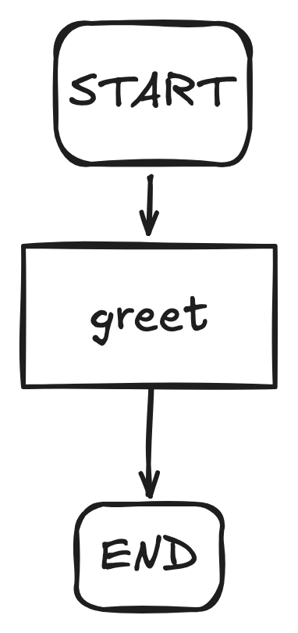
Nodes & Edges
Orchestration Framework: LangGraph
A node is a plain Python function. It takes the current state and returns a update.
  a node returns only the keys it changes
  START and END are built-in
  add_edge(START, "greet") marks where a run begins
  add_edge("greet", END) marks where it stops
from typing import TypedDict
from langgraph.graph import StateGraph, START, END
class State(TypedDict):
name: str
greeting: str
def greet(state: State) -> dict:
return {"greeting": f"Hello, {state['name']}!"}
builder = StateGraph(State)
builder.add_node("greet", greet)
builder.add_edge(START, "greet")
builder.add_edge("greet", END)

Slide 106
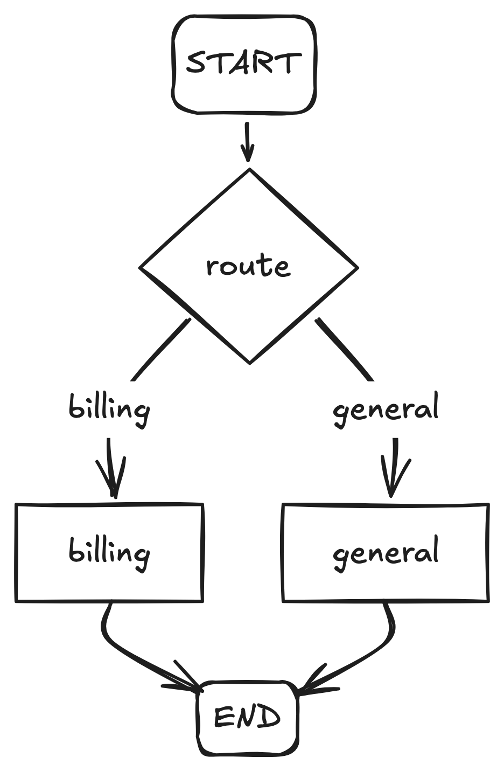
Nodes & Edges
Orchestration Framework: LangGraph
Conditional Edges
  Unlike a normal edge ( add_edge() ), A conditional edge asks a routing function what the state actually contains, then decides, more than one node could run next depending on the input.
def route(state: State) -> Literal["billing", "general"]:
return "billing" if "billing" in state["ticket"].lower() else "general"
def billing(state: State) -> dict:
return {"ticket": "Routed to billing"}
def general(state: State) -> dict:
return {"ticket": "Routed to general"}
builder = StateGraph(State)
builder.add_node("billing", billing)
builder.add_node("general", general)
builder.add_conditional_edges(START, route, ["billing", "general"])
builder.add_edge("billing", END)
builder.add_edge("general", END)

Slide 107
Nodes & Edges
Orchestration Framework: LangGraph
Conditional Edges
  Command is a newer alternative, it lets a node return a state update and the next node to route to in one return value, instead of a separate node plus a separate routing function.
from typing import Literal
from langgraph.types import Command
def classify_and_route(state: State) -> Command[Literal["billing", "general"]]:
text = state["ticket"].lower()
if "billing" in text:
return Command(update={"ticket": "Routed to billing"}, goto="billing")
return Command(update={"ticket": "Routed to general"}, goto="general")

Slide 108
States
Orchestration Framework: LangGraph
Every node so far has read from and written to state, the shared data structure that flows through the whole graph, defined once when StateGraph(...) is created, and touched by every node and edge along the way. There are 2 types that we can use based on use cases such as
  MessgesState is a built-in state from LangGraph. It uses for holding a conversation, a growing back-and-forth between a user and the model. it's just a TypedDict with one field, messages, pre-wired with logic that appends new messages (add_messages) instead of overwriting the old ones.
  Custom Schema State is a state you define yourself, instead of using LangGraph's built-in MessagesState. It's used whenever your graph's state isn't a conversation, or needs more than one, whatever fields your actual workflow needs to track, a ticket string, a retry count, a user ID.

Slide 109
States
Orchestration Framework: LangGraph
MessagesState use when:
  A customer support chatbot, where every reply has to account for everything the customer already said, not just their latest message
  A coding assistant that needs to remember which file or function you were just discussing three turns ago
  Any multi-turn Q&A where a follow-up ("what about the second one?") only makes sense next to the messages before it

Slide 110
States
Orchestration Framework: LangGraph
Example: MessagesState
from langgraph.graph import MessagesState
from langchain.chat_models import init_chat_model
from langgraph.graph import StateGraph
llm = init_chat_model(...)
builder = StateGraph(MessagesState)
def chat_node(state: MessagesState) -> dict:
response = llm.invoke(state["messages"]) # state["messages"] is the conversation so far
return {"messages": [response]} # append only the new reply, not the whole list

Slide 111
States
Orchestration Framework: LangGraph
Custom Schema State you can custom it using @dataclass and Pydantic BaseModel where
  @dataclass behaves like TypedDict but supports default field values
  Pydantic BaseModel checks incoming data live and automatically fixes minor type mismatches (for example, converting "123" to the number 123). This extra safety costs more processing time.
from dataclasses import dataclass
@dataclass
class State:
name: str
greeting: str = "" #supports default values
from pydantic import BaseModel
class State(BaseModel):
name: str
age: int = 0 # adds real runtime validation
on top of the default

Slide 112
StateGraph Assembly, Compilation & Invocation
Orchestration Framework: LangGraph
After we have known its main component. It is time for us to compile and run the graph flow (invoke).
  .compile(), runs a few structural checks (no orphaned nodes, every path reaches END, and so on) and returns a CompiledStateGraph
  the compiled graph exposes the invoke / stream ( ainvoke / astream is the async version)
  .stream() on a graph yields one update per super-step by default, not token-by-token like a model's own .stream(), useful for watching which node just ran rather than watching text arrive.
graph = builder.compile()
print(graph.invoke({"messages": [("human", "Hello")]}))

Slide 113
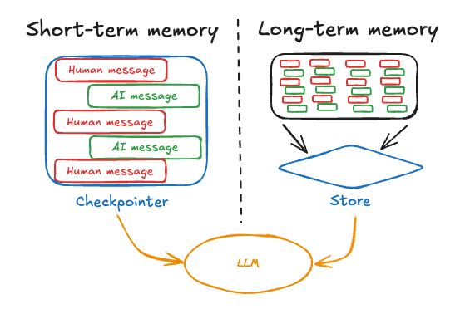
Memory & Checkpointing
Orchestration Framework: LangGraph
Without memory, nothing carries over between calls, each graph.invoke() starts from zero. LangGraph has 2 types of memory as below:
  Short-term memory: everything that happened within one thread, one ongoing conversation. Scoped to a single thread_id.
  Long-term memory: information that follows a user, or an account, or whatever key you choose, across separate threads, conversations that have nothing to do with each other but should still share context.

Slide 114
Memory & Checkpointing
Orchestration Framework: LangGraph
Checkpointer handles the short-term memory using InMemorySaver(), it stores checkpoints in a Python dict in RAM. thread_id is the key that scopes this, two calls with the same thread_id share history, a different thread_id starts a brand new, empty conversation on the same compiled graph.
from langgraph.checkpoint.memory import InMemorySaver
from langgraph.graph import StateGraph
builder = StateGraph(State)
checkpointer = InMemorySaver()
graph = builder.compile(checkpointer=checkpointer)
config = {"configurable": {"thread_id": "conversation-1"}}
graph.invoke({"messages": [("human", "My name is Ada.")]}, config)
result = graph.invoke({"messages": [("human", "What's my name?")]}, config)
print(result["messages"][-1].content)

Slide 115
Memory & Checkpointing
Orchestration Framework: LangGraph
Core Usage of Checkpointer
  Short-term memory: pass the same thread_id, get the same conversation back.
  Human-in-the-loop, pause and resume: interrupt() pauses a node mid-run and waits for outside input, checkpointing is what makes the pause survivable, state has to persist while nothing is happening. Resuming happens via Command(resume=...), same thread_id, later call.
  Time travel and forking: every checkpoint is inspectable and replayable. get_state_history() lists past checkpoints for a thread, update_state() writes a modified value into one of them, creating a new checkpoint, invoking from that checkpoint's config replays or forks from that exact point instead of the start.
  Fault tolerance: if a node fails partway, a network timeout, a crash, resuming with the same thread_id picks up from the last successfully completed step, not the beginning. No re-running (and re-paying for) work that already finished.

Slide 116
Memory & Checkpointing
Orchestration Framework: LangGraph
Store handles long-term memory using InMemoryStore()
  namespace scopes an entry to one specific thing, under ("users", "user_123") belongs to that one user
  key names one entry inside that folder, value is the actual data, any JSON-serializable dict
  a node reads and writes the store the way it reads and writes state, just through a separate store parameter instead
from langgraph.graph import StateGraph
from langgraph.store.memory import InMemoryStore
store = InMemoryStore()
# namespace scopes this entry to one user, key and value are yours to define
store.put(("users", "user_123"), "preferences", {"favorite_color": "blue"})
builder = StateGraph(State)
graph = builder.compile(store=store)

Slide 117
Memory & Checkpointing
Orchestration Framework: LangGraph
Core Usage of Store
  Personalization: a user's preferences, remembered once, available in every future conversation with them, not just the one where they mentioned it.
  Cross-session facts: something learned in one conversation, a stated goal, a dietary restriction, still known in a completely separate, later one with no thread in common.
  Semantic search over memories: store.search(namespace, query="dietary restrictions") finds relevant entries by meaning, not exact key, useful once a user's namespace holds many unrelated facts and you don't know which key has what you need.

Slide 118
Memory & Checkpointing
Orchestration Framework: LangGraph
Checkpointer and Store
  Note: InMemorySaver and InMemoryStore, are both lost the moment the process exits, fine for development, not for anything real.
 | Memory type | When to use it | Real-world example | Durable alternatives
Checkpointer | Short-term (one thread) | Keeping track of one ongoing chat | A chatbot recalling what you said two messages ago | SqliteSaver, PostgresSaver
Store | Long-term (across threads) | Remembering something across separate chats | Remembering a user's favorite color the next time they open a brand new chat, days later | SqliteStore, PostgresStore

Slide 119
Graph Visualization
Orchestration Framework: LangGraph
After the graph has been fully build we can visualize it using:
  .get_graph() looks at the graph's structure only, it doesn't run anything
  .draw_mermaid() turns that structure into Mermaid diagram text, paste it into mermaid.live to see it drawn, no notebook needed
  .draw_mermaid_png() does the same thing but returns an actual image instead of text, use display(Image(graph.get_graph().draw_mermaid_png())) inside a Jupyter notebook to see it inline
  xray=True on get_graph() only matters once a graph contains another graph nested inside it (a subgraph),
print(graph.get_graph().draw_mermaid())

Slide 120
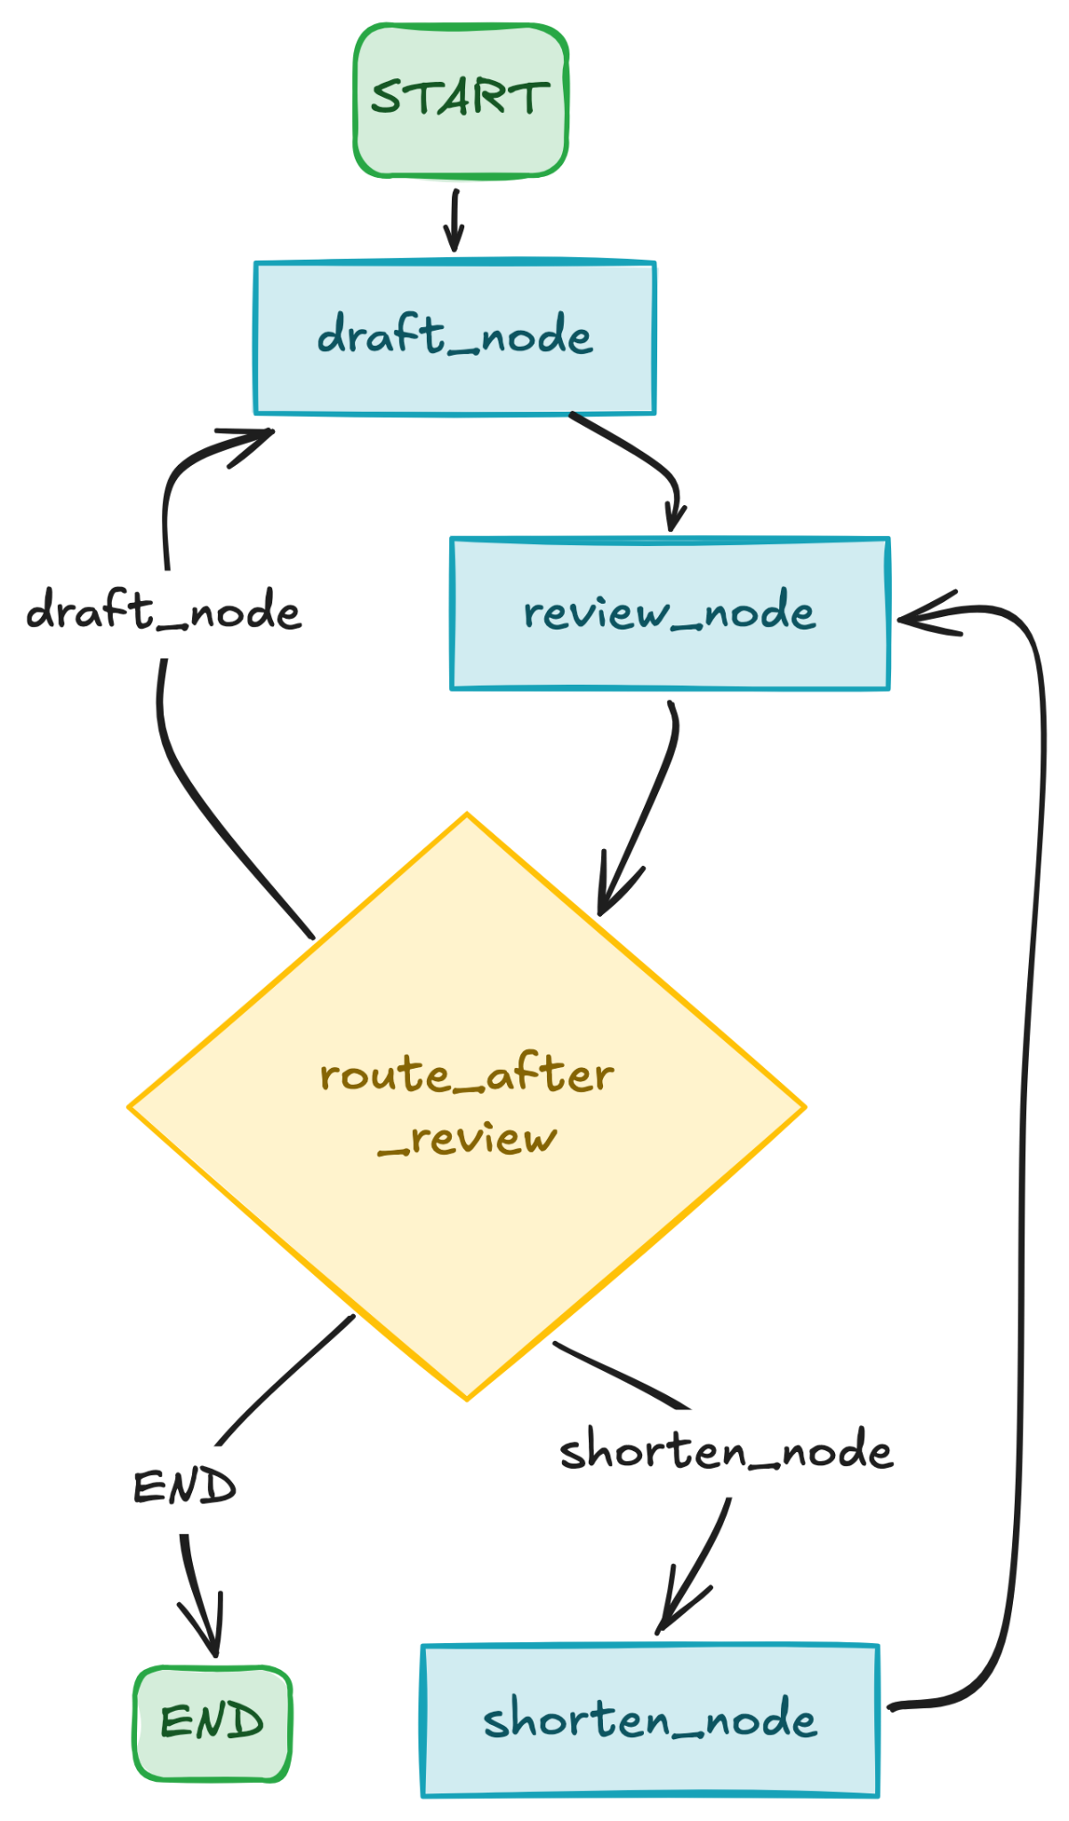
Putting Everything Together
Orchestration Framework: LangGraph
This code builds a workflow that:
  drafts a product description in a saved brand voice
  reviews it against two rules: under 30 words, mentions the price
  routes to one of three outcomes:
    approved (done, saved for next time),
    too long (shortened, re-reviewed),
    anything else wrong (redrafted with feedback, re-reviewed)
  loops up to 3 times before giving up
Github Link

Slide 121
References

Slide 122
References
Modular Workflow Design
  LLM Application Architecture: A 2026 Engineer's Guide (MLflow)
  Specifications: The missing link to making LLM systems an engineering discipline
  Modular LLM Architectures (compositionality, extensibility, scalability)
LlamaIndex
  LlamaIndex overview (main docs)
  OpenAILike (LLM) reference
LangChain
  LangChain overview (main docs)
  Runnable interface, full method reference
LangGraph
  LangGraph overview (main docs)
  StateGraph reference

Slide 123
THANK YOU
" Write programs that do one thing and do it well. Write programs to work together. ”
– Doug McIlroy, Unix philosophy

